Slide 1

Welcome to
EdrawMax PowerPoint Add-in
Turn ideas into visuals effortlessly — six simple steps to a polished presentation
https://www.edrawmax.com/ppt/

Slide 2




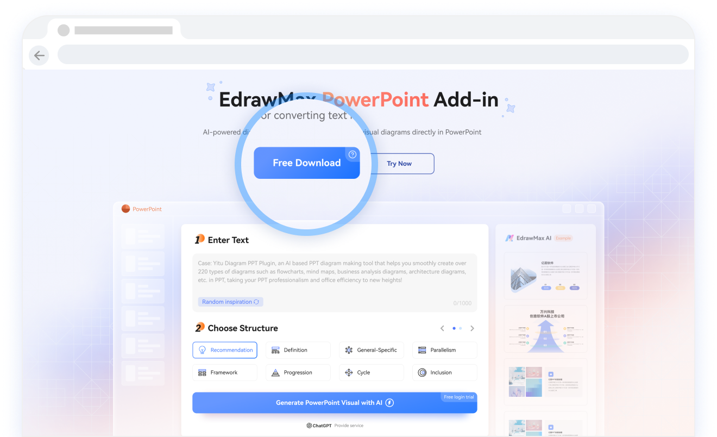
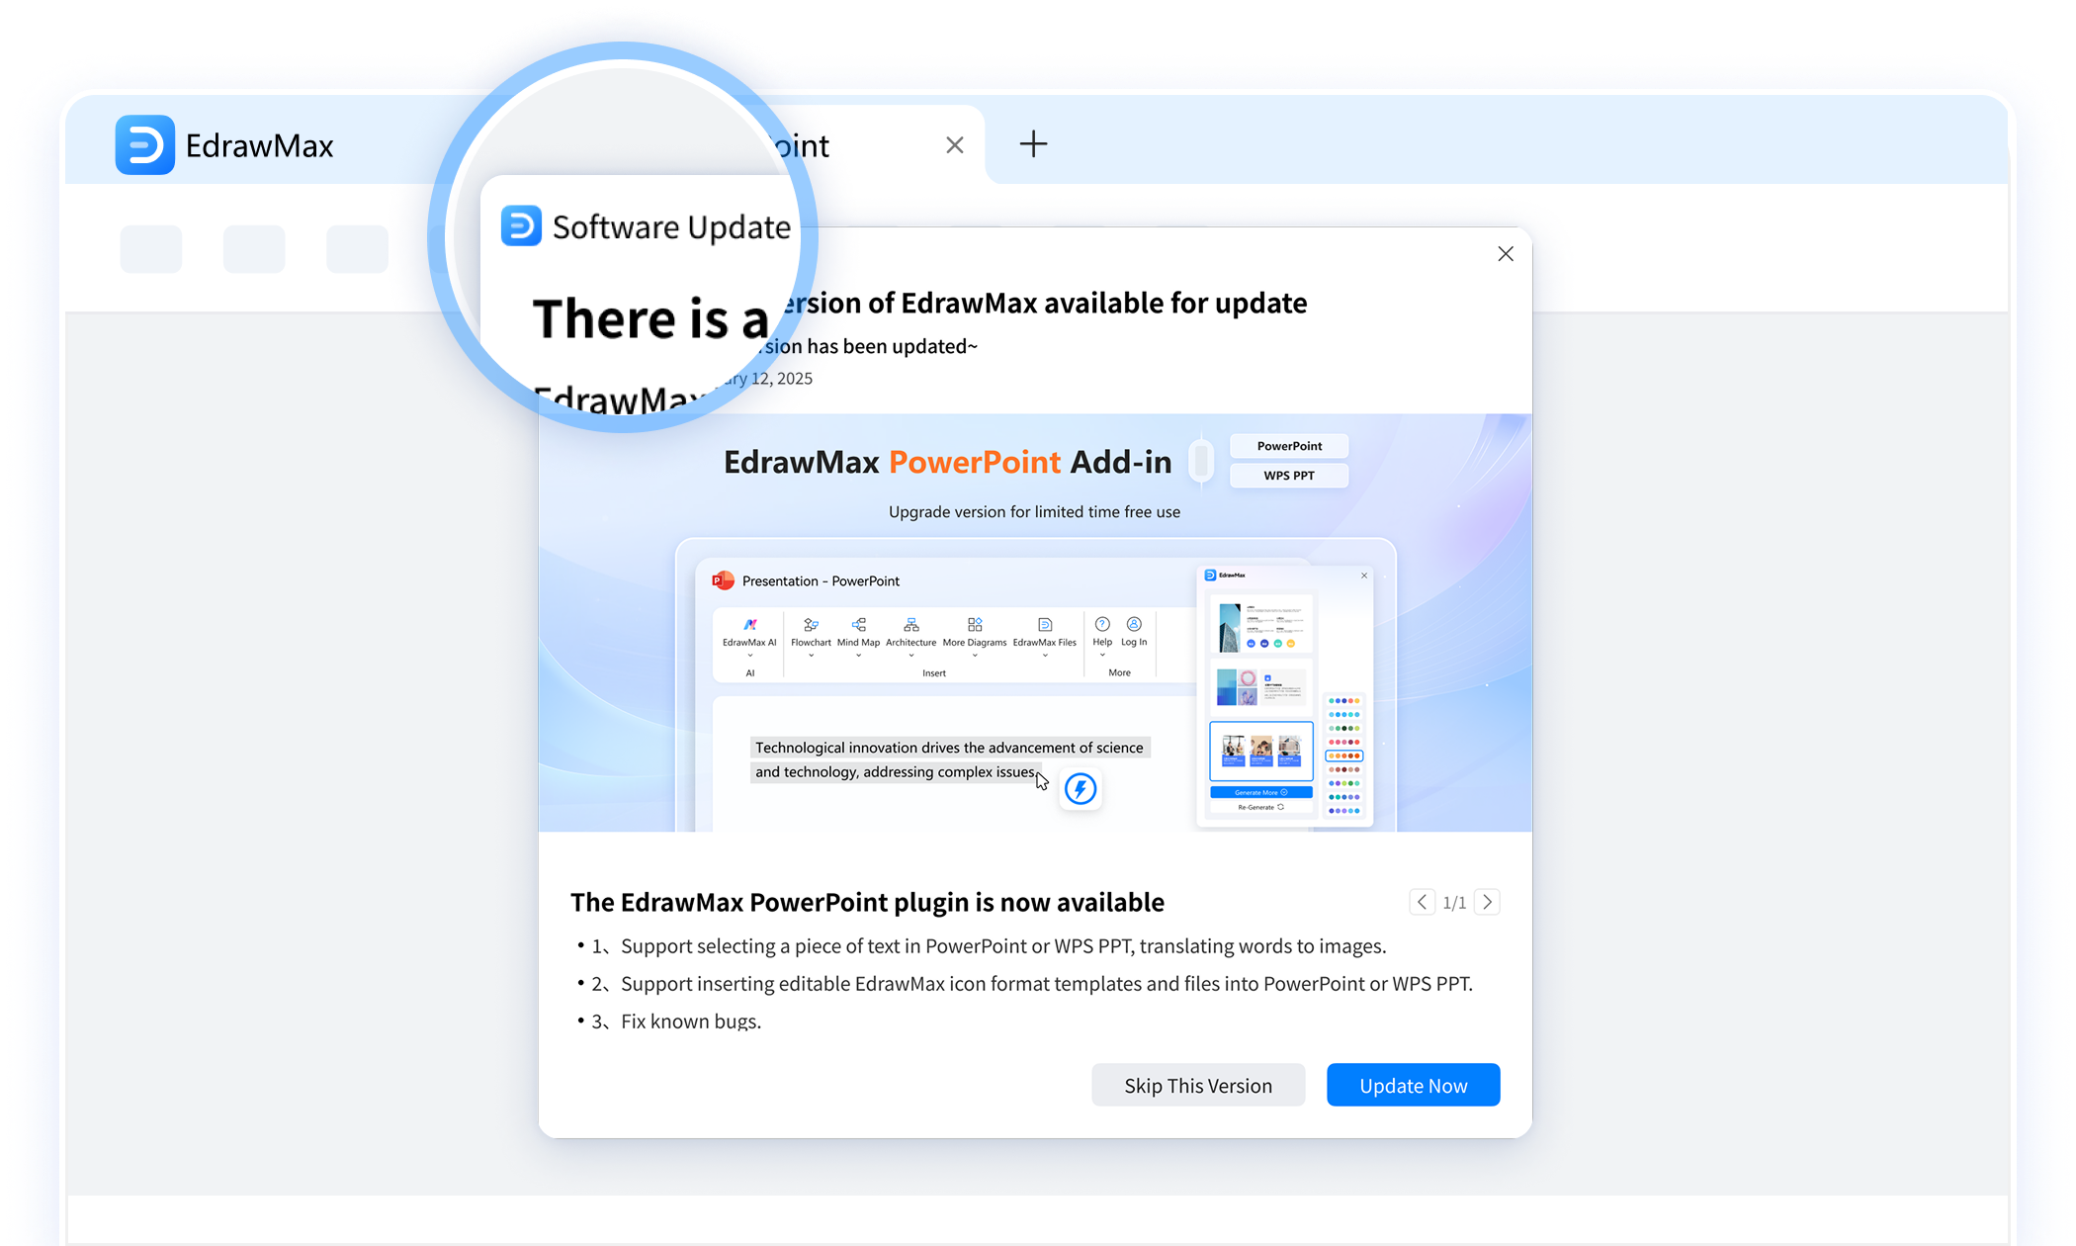

Step 1: Download, Install, and Update
Download & Install
Update
Download the EdrawMax Windows version, including the add-in, from https://www.edrawmax.com/ppt/ and follow the installation guide. (If you came to PowerPoint by clicking through from the EdrawMax Windows version homepage, you can skip this step.)
The add-in updates automatically with the EdrawMax Windows version. When you install a new version, the latest add-in will launch automatically in PowerPoint.

Slide 3






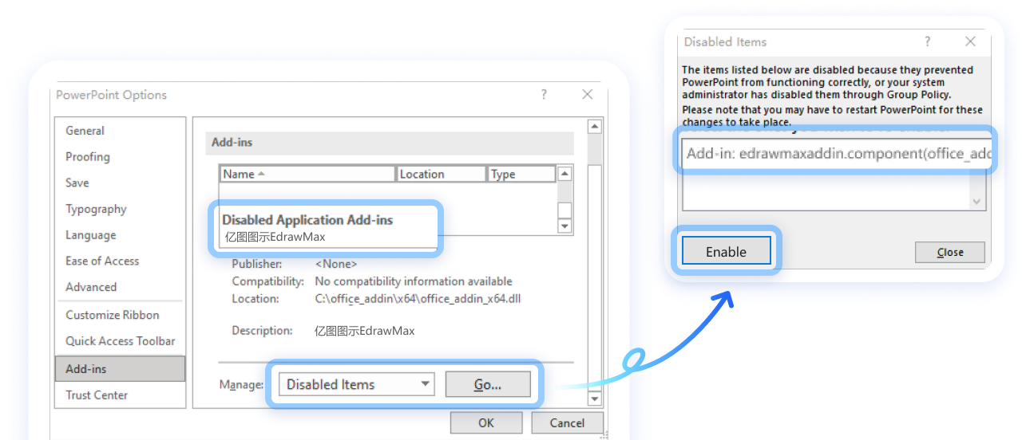
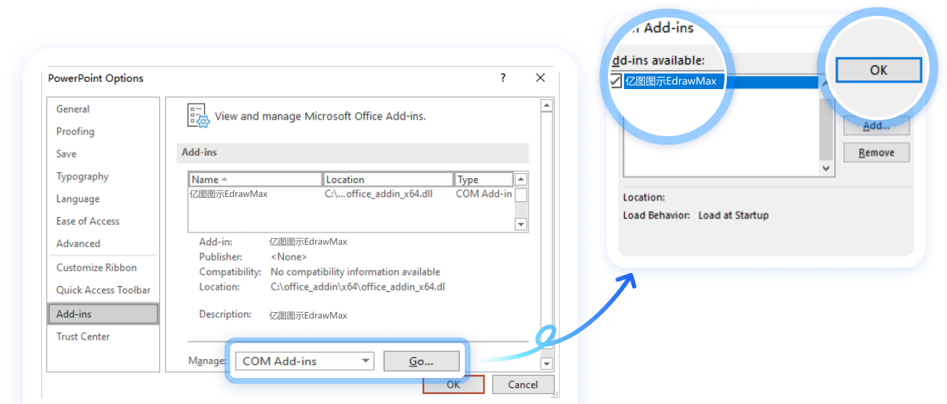

Step 2: Check for "EdrawMax" in the PowerPoint Top Menu
After "Download & Installation" is complete, "EdrawMax" usually automatically appears in the "PowerPoint top menu bar."
If it does not appear, try the following methods:
File -> Options -> Add-ins -> Check if "亿图图示EdrawMax" is listed under "Disabled Application Add-ins."
Case 1: If listed -> Manage -> Disabled Items -> Go -> Select Add-in: edrawmaxaddin.component -> Enable -> OK
Case 2: If not listed -> Manage -> COM Add-ins -> Go -> Check 亿图图示EdrawMax -> OK

Slide 4

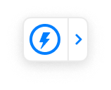
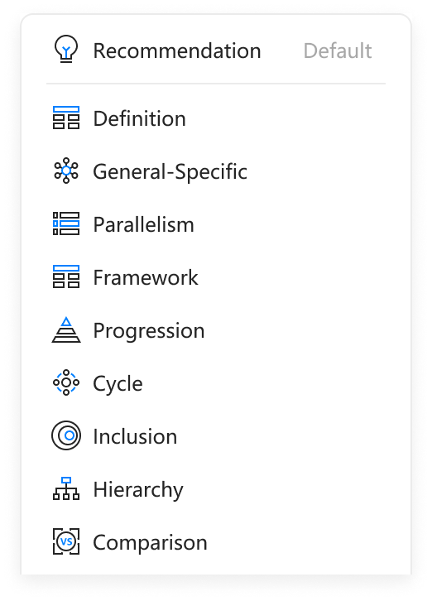
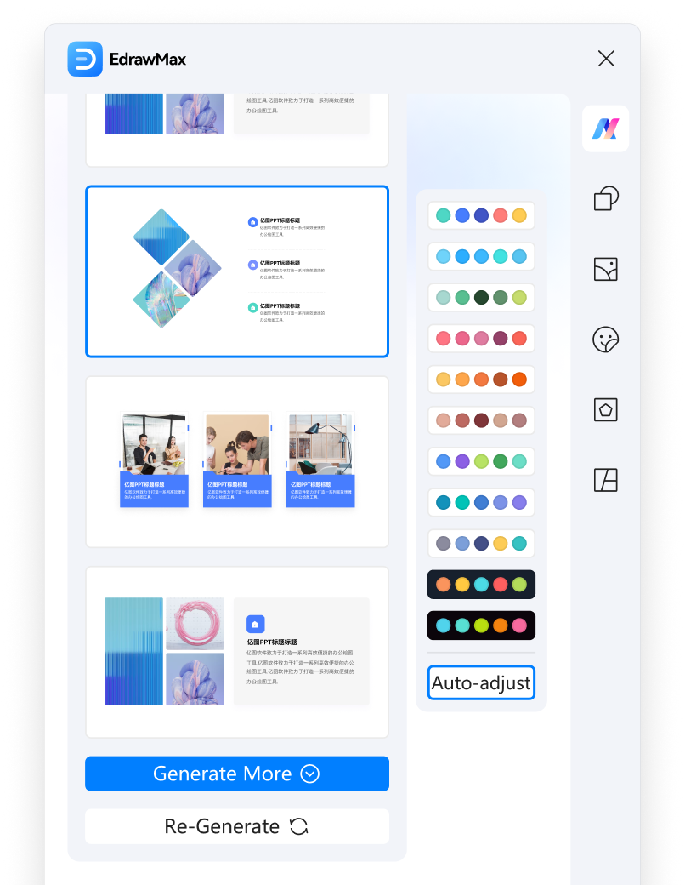
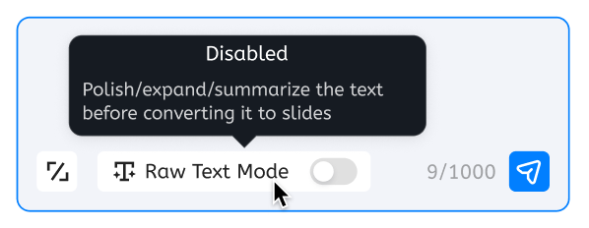

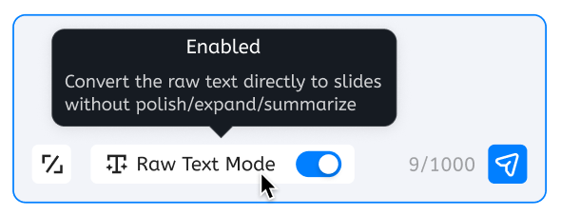
Step 3: Try Text-to-Slide
Convert text into visually appealing diagrams with a single click
Tip 1
Choose structure type
Tip 2
Raw text mode
Tip 3
Auto-adjust to slide color
Disabled
For a sentence or draft needing AI optimization.
Enabled
For final text, no AI modification needed.
Notes:
关闭：适用于一句话、一段草稿，需要AI优化

Slide 5
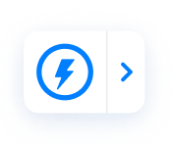


Step 3: Try Text-to-Slide
Select the text below and click the nearyby“Text-to-Slide” icon
Tips:
To prevent the Text-to-Slide "lightning icon" from appearing after text selection, disable "mouse follow". You can then access this function later from the top menu: "Edraw Max" -> "Text-to-Slide".
If "Text-to-Slide" still doesn't work after selecting the text, click "EdrawMax AI" in the top menu bar -> Enter Text -> Send, to achieve the same result
Artificial intelligence
Artificial intelligence is abbreviated as AI in English. It is a new technical science that studies and develops theories, methods, techniques, and application systems for simulating, extending, and expanding human intelligence.
Evolution of Modern Education
Modern education has shifted from knowledge transfer to skill development, emphasizing critical thinking, communication, and innovation.
Subtropical vs. Temperate Climates
Artificial intelligence is abbreviated as AI in English. It is a new technical science that studies and develops theories, methods, techniques, and application systems for simulating, extending, and expanding human intelligence.

Slide 6

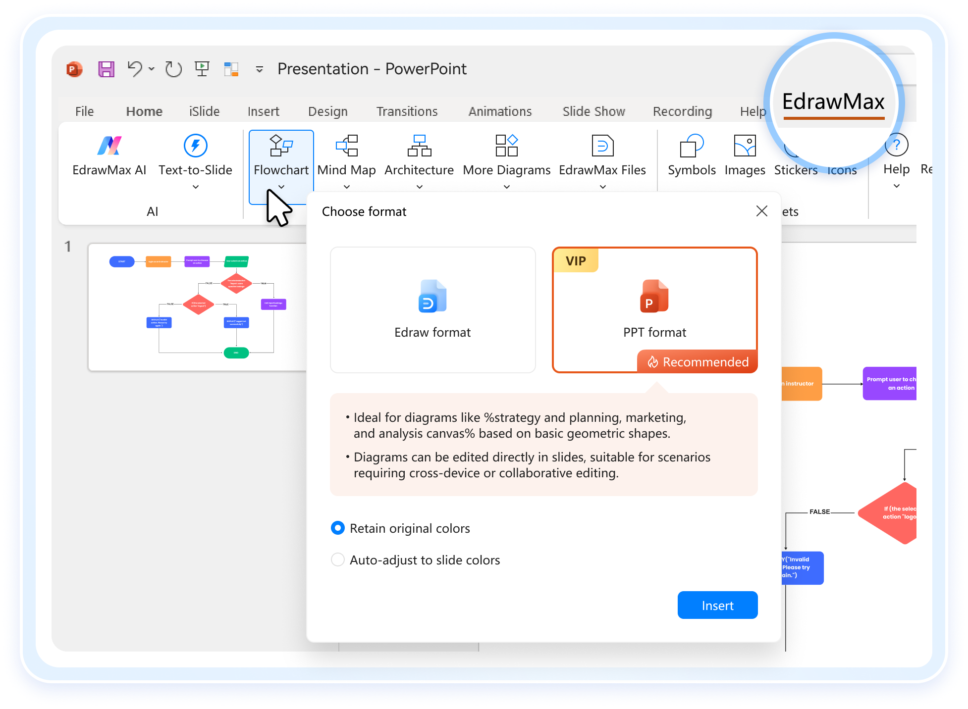

Step 4: Insert Diagrams
Insert a template of flowchart, mind map, architecture, or open existing EdrawMax files
When inserting, choose between EdrawMax format or slide format. Option to auto-adjust to slide colors is also available.

Slide 7

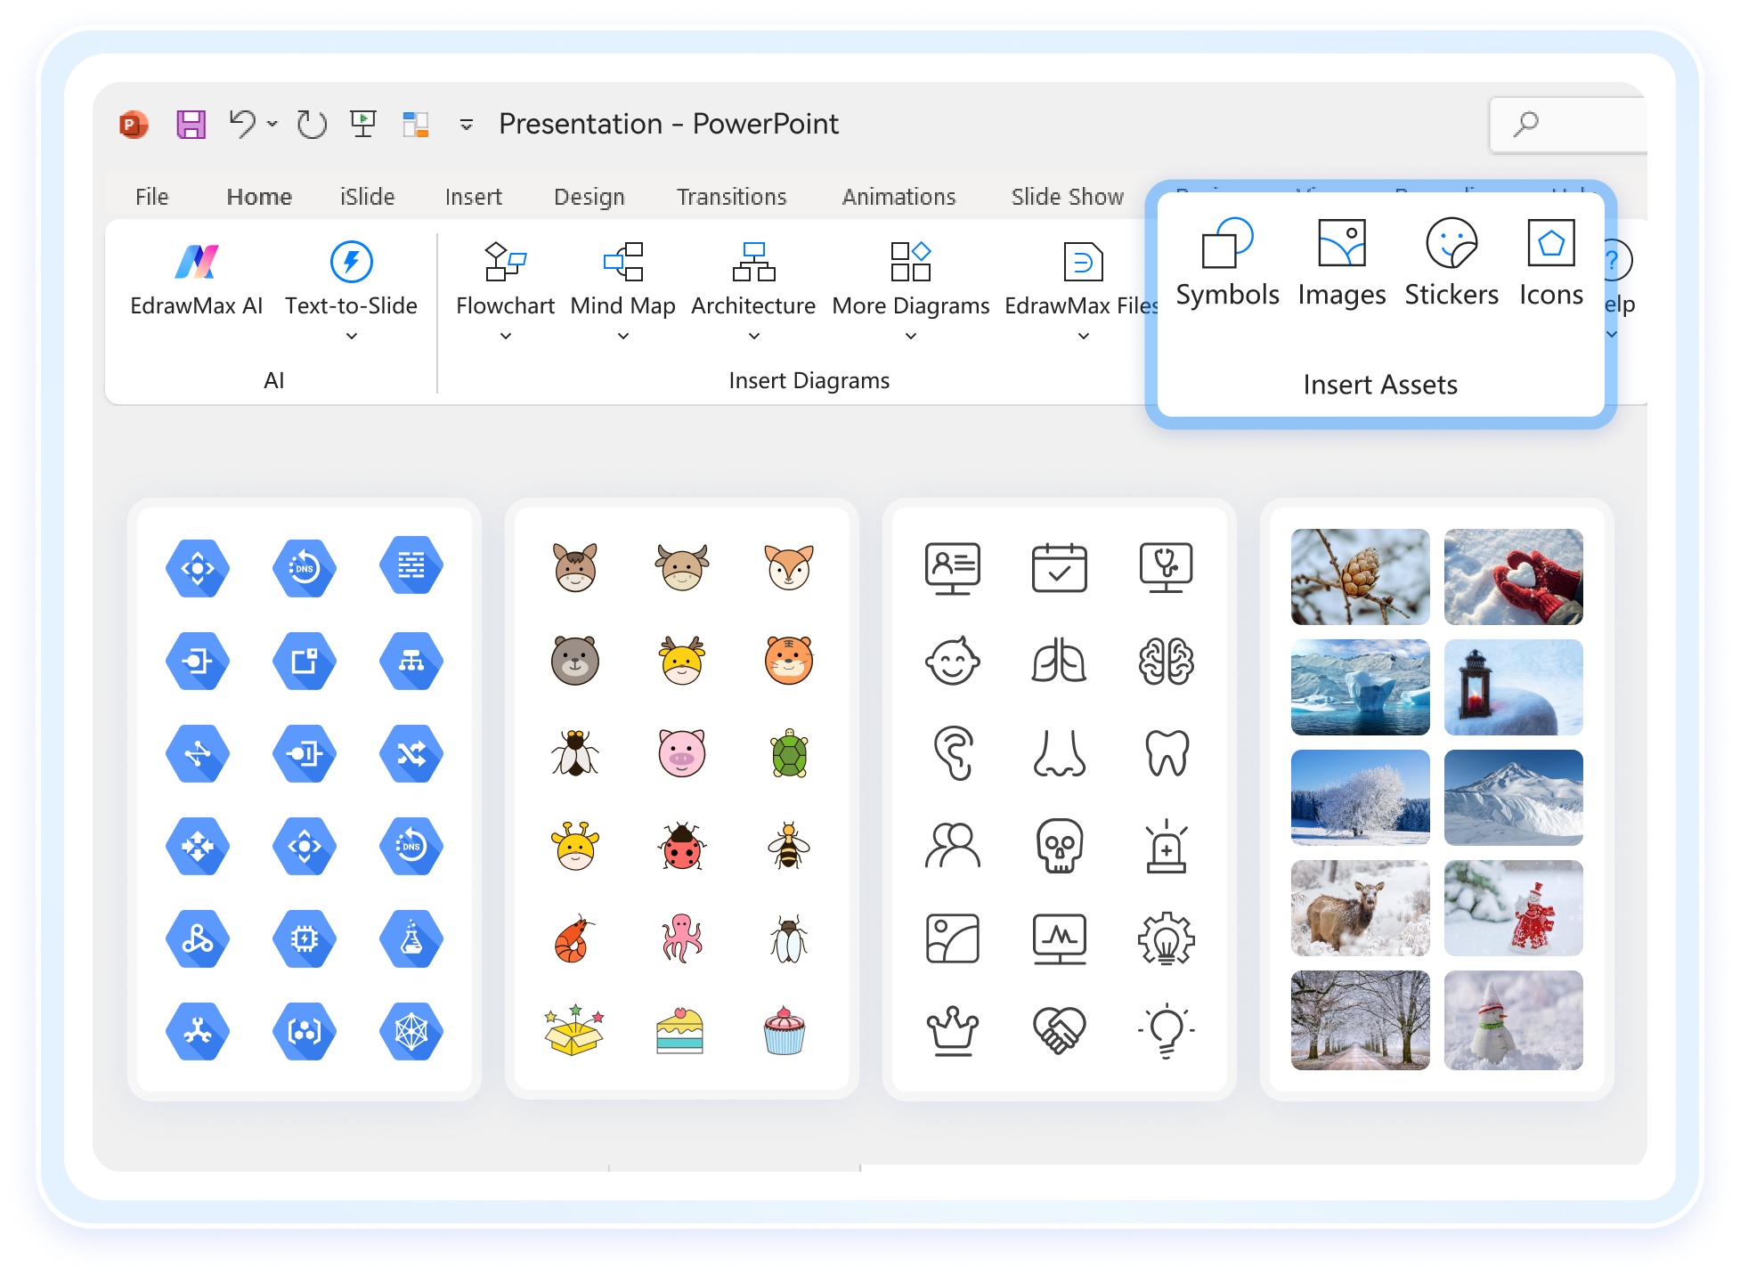

Step 5: Edit Diagrams
Access over 100,000 high-definition vector symbols, stickers, icons, and images.

Slide 8


Step 6: FAQ
I don't need the "Text-to-Slide" feature Now. How do I disable it?
Top menu bar -> EdrawMax -> Text-to-Slide dropdown menu -> Disable Mouse Follow -> The Text-to-Slide icon will no longer appear automatically in PowerPoint.
I don't need the "EdrawMax PowerPoint Add-in" Now. How do I disable it?
File -> Options -> Add-ins -> Go -> Uncheck “亿图图示EdrawMax" -> OK -> The "EdrawMax" will no longer appear in the top menu bar.
After using Text-to-Slide, why does the text content and number of points in the diagram not exactly match the original text?
Considering that the original text may vary in length and structure, in order to make the result of Text-to-Slide more suitable for structured presentation on a single-page slide, the AI model will refine, expand, and restructure the text, which may lead to some differences from the original text.
Why does my PowerPoint have two "Edraw" add-ins?
If your text is finalized and you want to directly convert it to an slide without AI expansion, polishing, or summarization, try enabling “Raw Text Mode".
Currently, Edraw offers two PowerPoint add-ins: "EdrawMax" and "EdrawMind", which are downloaded, installed, and updated along with their respective Windows versions. The functions of the two add-ins are different, and you are welcome to use them selectively based on your needs.

Slide 9
Step 6: FAQ
Is the Edraw account the same as the Microsoft account?
No, they need to be registered and logged in separately.
How can I provide feedback or share my ideas with the EdrawMax team?
We value your feedback! Let us know by filling out this form: https://forms.office.com/r/BHF2pww76r

Slide 10

Congratulations on completing the tutorial.
Thank you for using EdrawMax PowerPoint add-in!

